Slide 1

Nessus

Slide 2
Nessus
Nessus is a Vulnerability Scanner
Vulnerability scanner have the same principle that they have a database which contains non-vulnerability data.
These scanners scan this database and identify the vulnerability.
The most important of these scanner is Nessus.

Slide 3
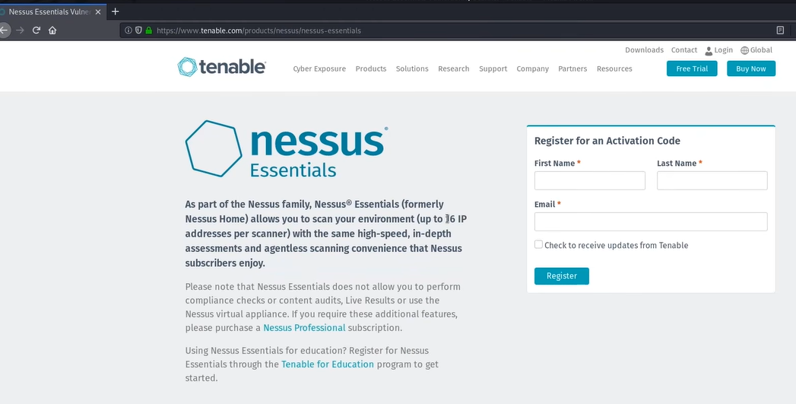
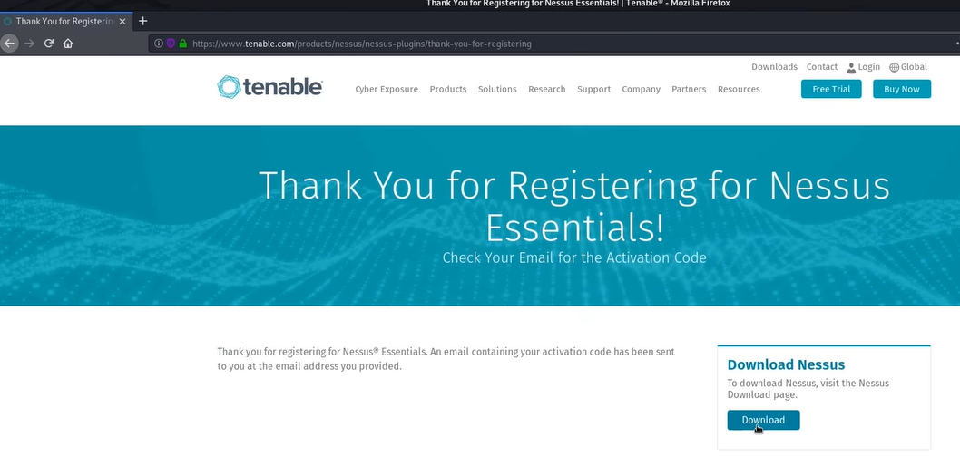
Installation of Nessus
Goto: google> Nessus Essential Download
or
https://www.tenable.com/product/nessus/nessus-essentials.
Register your self and then download
For kali Debian 64 (Nessus-8.10.1-debian6_amd64.deb)

Slide 4
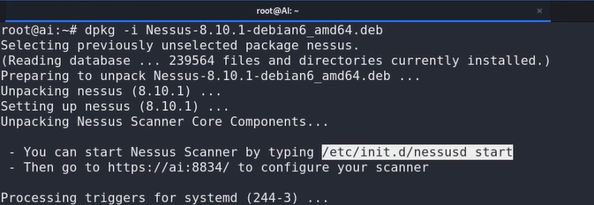
Installation of Nessus
In kali: $ dpkg -i Nessus-8.10.1-debian6_amd64.deb
After installation, To start service
$ /etc/init.d/nessusd start

Slide 5
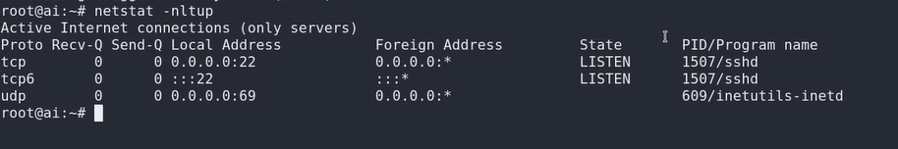
Nessus
By the following command we can know which port is being listened by kali.
$ netstat –nltup
This command output is showing that Nessus port is not available till now.
As we start the service of Nessus, one port will be available
$ /etc/init.d/nessusd start //Starting Service
$ netstat -nltup //Checking

Slide 6
Nessus
If not available then do:
$ systemctl restart nessusd.service
$ netstat -nltup
Now we can see Nessus port is available.
Now use the IP to open Nessus interface, first check IP: $ ipconfig
Now Open Browser type: https://Kali_IP:Port
On browser (If asking) then select Advance>Accept the Risk and Continue
Note: To use https protocol.

Slide 7
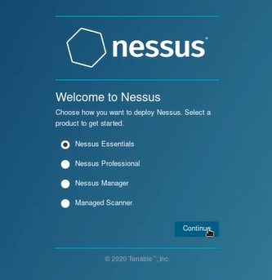
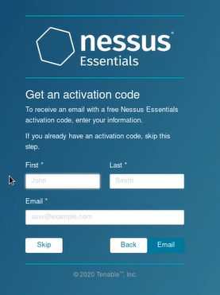
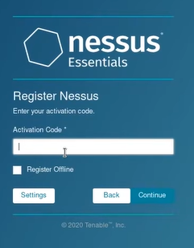
Nessus
Select Nessus Essential>Continue
Register> Use activation code received on email> Continue

Slide 8
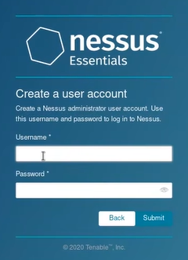
Nessus
UserName: admin
Password: admin
It will take time to install plugin

Slide 9
Thankyou

